Slide 1
Cyber trust
CYBR 4580/8950 Milestone 3

Slide 2

outline
Project Summary – Initial Scope to Current Scope
Methodology
Site Mockups to Reality
Project findings and outcomes
demo

Slide 3


Project summary
Initial-scope.js
Segment the user base into Administrative and User groups to allow separated functionalities.
Provide an administrator screen which will provide a consolidated toolset for creating reports.
Create a user statistics screen to display analytics relating to individual usage.
Created administrator dashboard to display organizational statistics from phishing tests
Utilized already existing analytics and displayed them in a meaningful fashion
Created alerting mechanisms to inform system administrator of which personnel are more at risk compared to others in collected population

Slide 4

Methodology
WHAT WE NEEDED TO ASK
What information would be important to the end user
What information does cyber trust collect already
What can we display to the end user
What information can we display that is useful to the end user

Slide 5
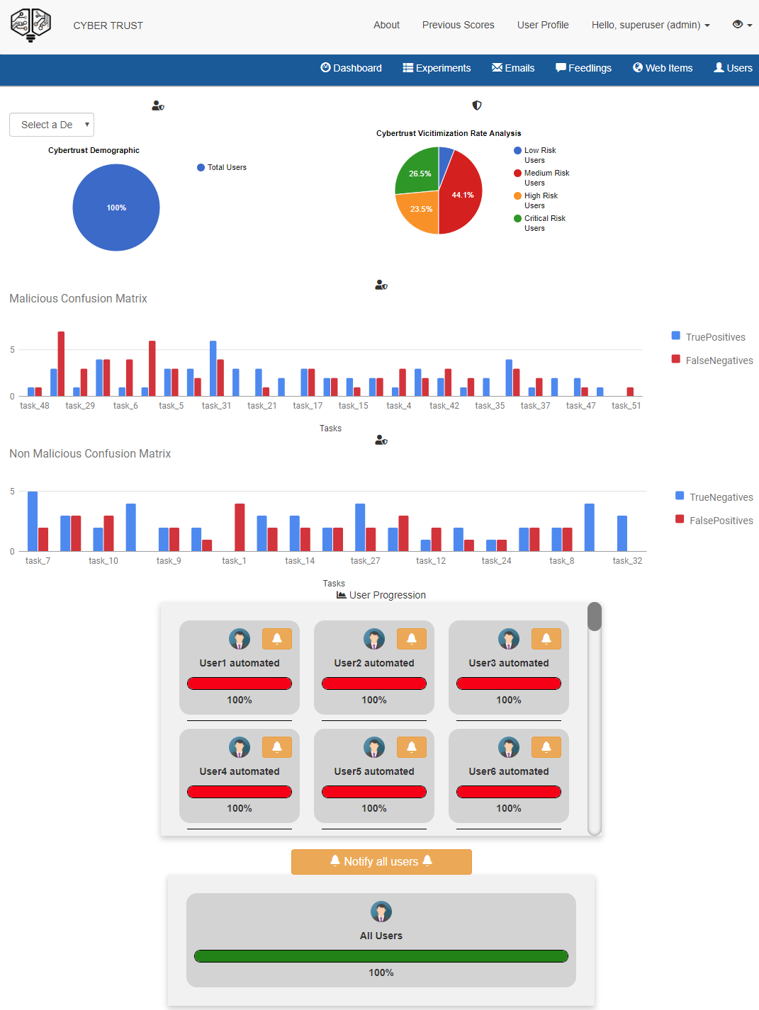





Methodology
1
WHAT WE HAD TO WORK WITH
What could we display on one page
What demographics can we use to tailor presented data
What limitations exist using established data sets
3
2

Slide 6
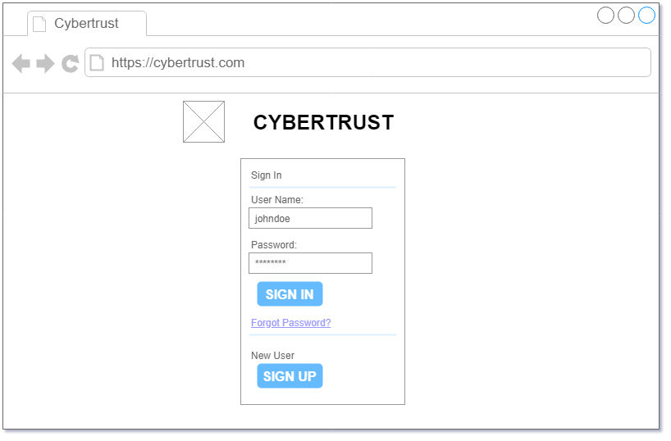
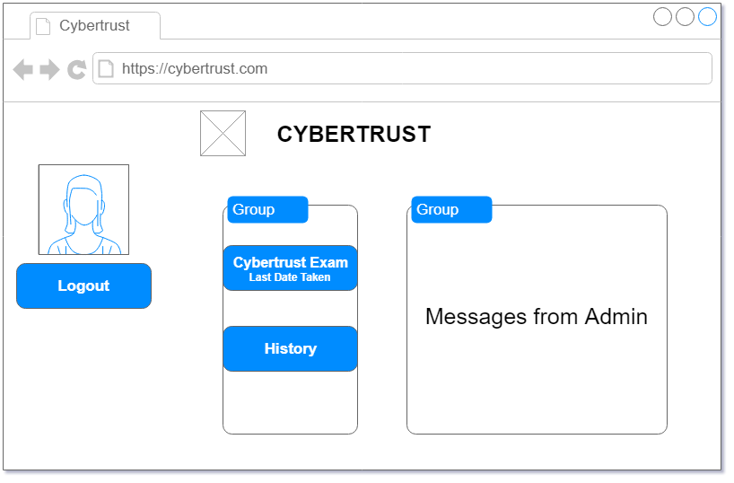
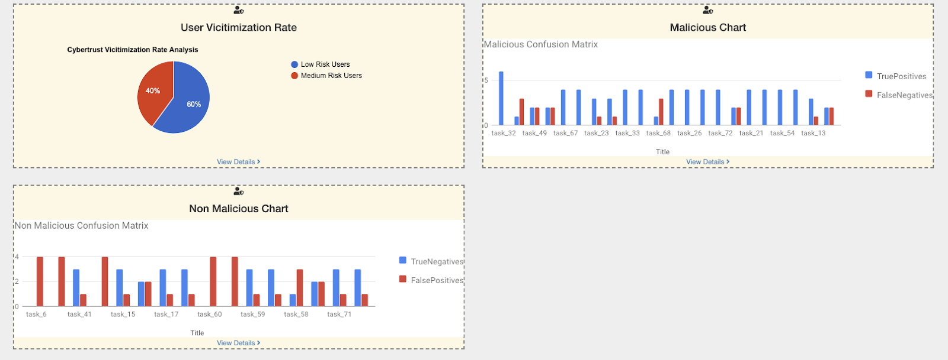
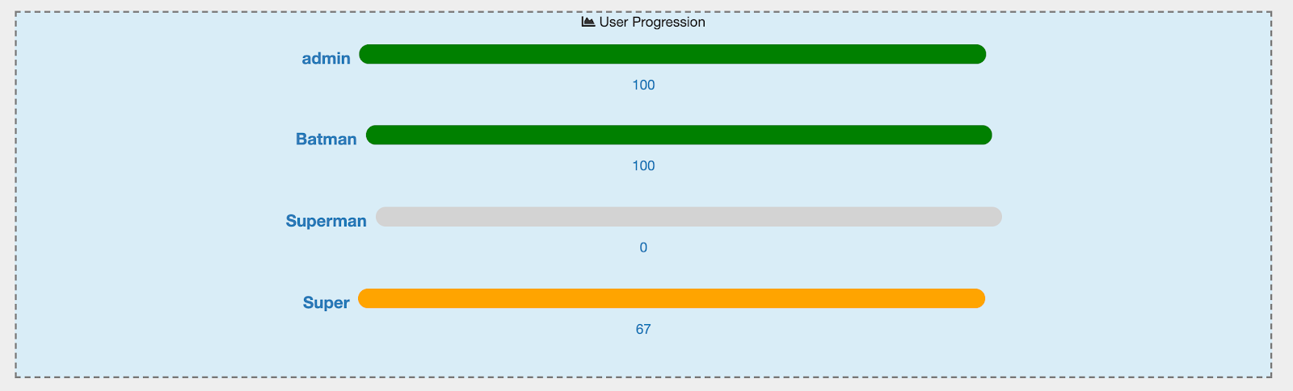
Mockup
FROM CONCEPT TO PRODUCTION
Infrastructure already existed
Original designs would have reinvented many items that already existed
Needed to rebuild after understating what was collected
No need to reinvent the wheel

Slide 7
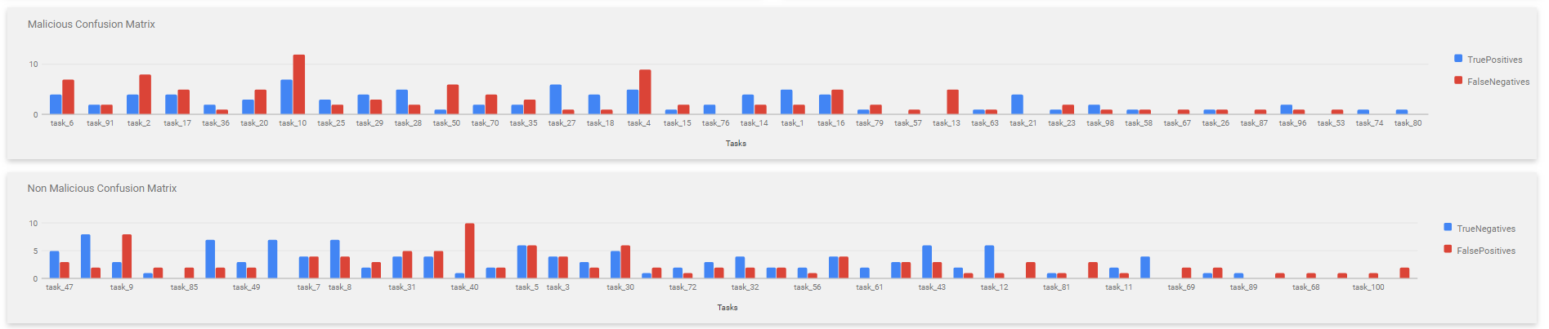
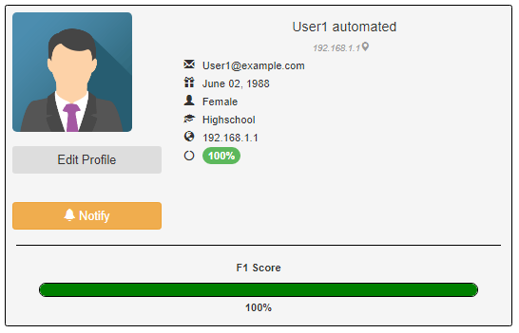
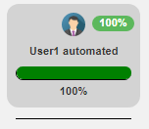
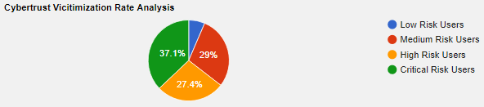
Mockup
WHAT IT LOOKS LIKE NOW
Design choices make use of data collected
Data presented in a way that gives the end user nothing but useful information
Visually appealing and informative

Slide 8
Mockup
WHAT IT LOOKS LIKE NOW
Separated graphs into malicious and non-malicious matrixes
Displays true positive / false negative
Displays true negative / false positive

Slide 9
Mockup
WHAT IT LOOKS LIKE NOW
Separate users into 4 categories based on how they answer test
Low risk
Medium risk
High risk
Critical risk

Slide 10
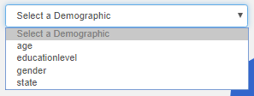
Mockup
WHAT IT LOOKS LIKE NOW
Allow data to be scoped
Age
Education
Gender
State / location

Slide 11
Mockup
WHAT IT LOOKS LIKE NOW
Quick user overview
End user can see users f1 score
End user can see users completion rate

Slide 12
Mockup
WHAT IT LOOKS LIKE NOW
Detailed user overview
End user can edit user profile
End user can notify at risk individuals from screen

Slide 13
Product findings
Data collected from phishing test can allow organizations to understand which employees need training
Data collected can be used to assign risk to different departments
Data collected can be used to request cybersecurity training
Data collected can be used to observe how well current training is applied

Slide 14
Progress report – milestone 3
This milestone allowed the team to work more closely with the data effectively
Team was able to focus original concepts and ideas into realized examples
Focused on separating data using demographics
Continued to use existing framework throughout project
Django
Ember.js
Abandoned zing charts due to limited activity with community in project
Focused on how best to display collected data to end user

Slide 15
demo
http://capstone.cornsec.pw

Slide 16



questions
Data side
Display side
How we coped
Fadila Kangaye
Taraka Vishnumolakala
Jake Robinson
Michael Galde
Austin Nielsen
Jake Robinson
Coffee
git reset --hard origin/capstone
Red bull / energy drinks

